Slide 1
UI AND UX
ASSIGNMENT
ROSHAN
24

Slide 2
What is UI?
User Interface
* UI stands for User Interface.
* It is the visual part of an app or website.
* It includes buttons, colours, fonts, icons and layout.
* It focuses on how the product looks.
Example:
* Instagram’s buttons, icons, colours and fonts.

Slide 3
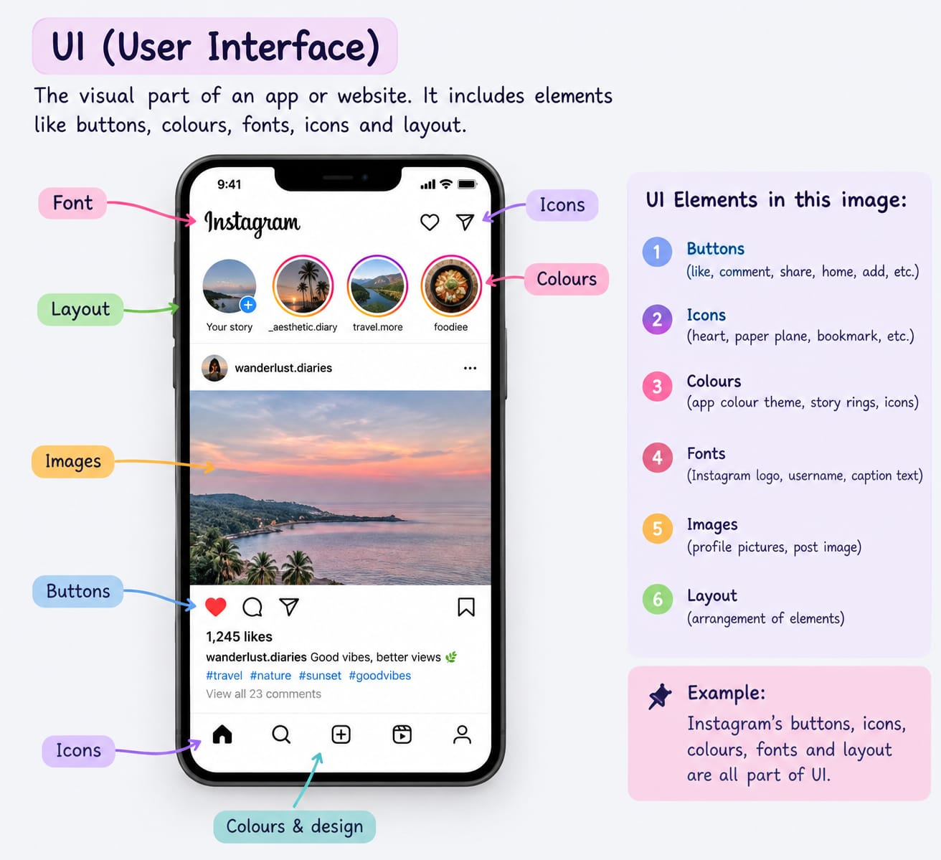
UI image

Slide 4
What is UX?
User Experience
* UX stands for User Experience.
* It is the overall experience of the user.
* It focuses on ease and comfort of using an app or website.
* It aims to make the product simple and user-friendly.
Example:
* Instagram makes it easy for users to upload and share a photo. This is an example of good UX.

Slide 5
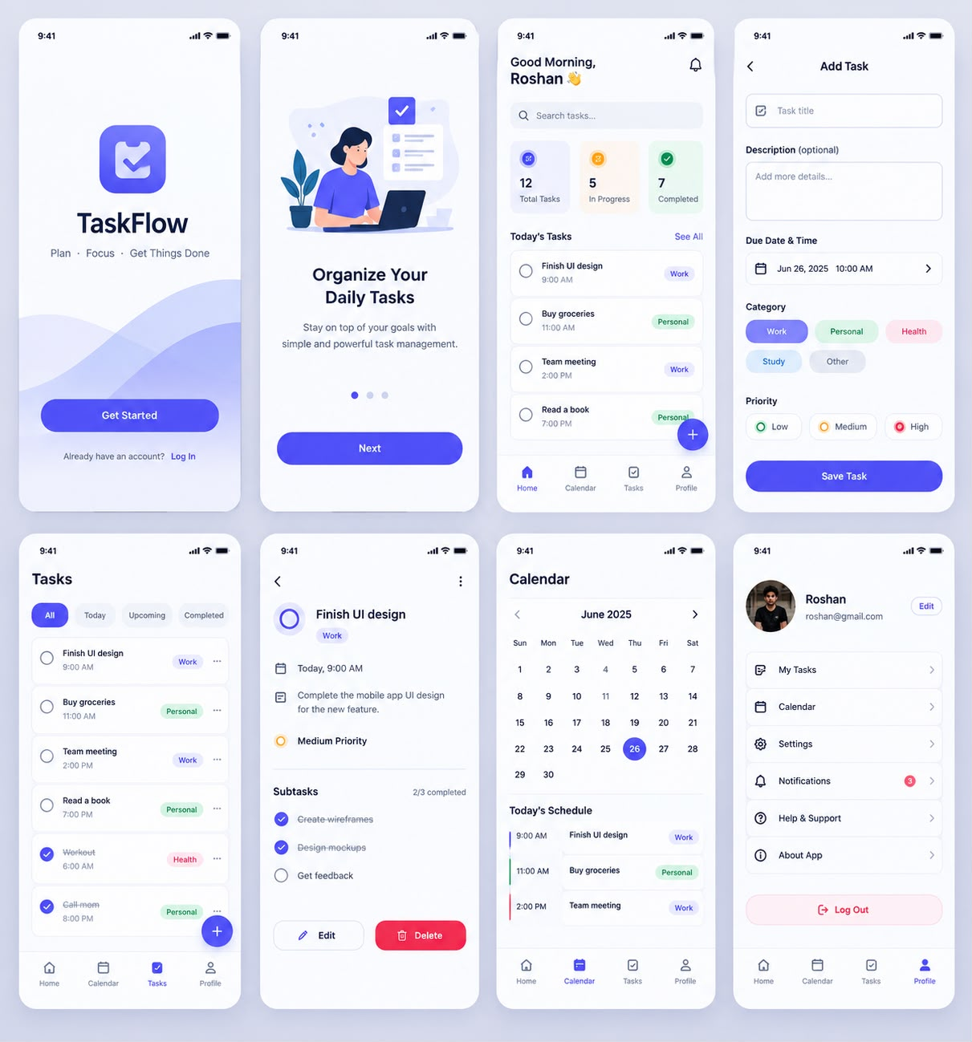
UX image

Slide 6
UI and UX image

Slide 7
UI and UX concept
UI decides what the restaurant cards, buttons, menus, colors, icons, and checkout screens look like.
UX decides how a user searches for food → chooses a restaurant → adds items → pays → tracks delivery.

Slide 8
Thank You!
INTRODUCTION TO UI AND UX

